Slide 1


Sunny Days “You Are My Sunshine”Challenge NASA SpaceApps
Joseph Sleiman, Kuenzang Losel & Lilli Freischem

Slide 2
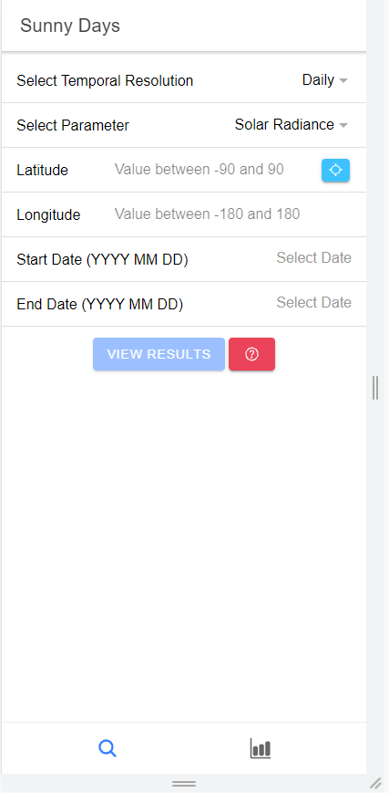
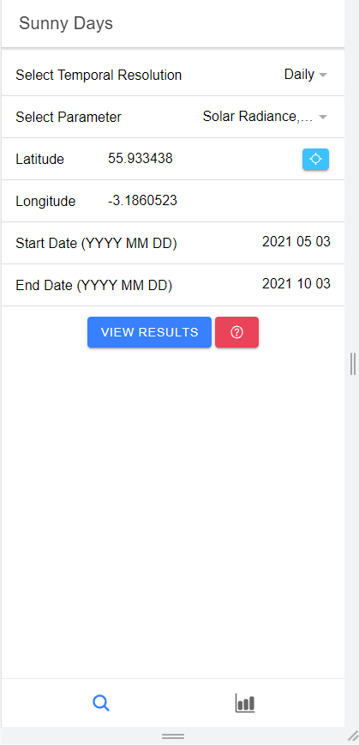
Sunny Days Mobile App – Home Page
Requesting user input for meteorological request
Blue button next to coordinates requests GPS access that automatically inputs the user’s geolocation coordinates
Press “View Results” to visualise data in graph form
Press “red question mark” button to see definitions of each parameter

Slide 3
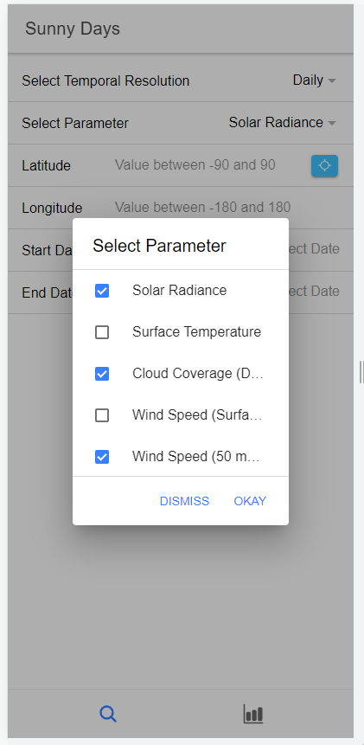
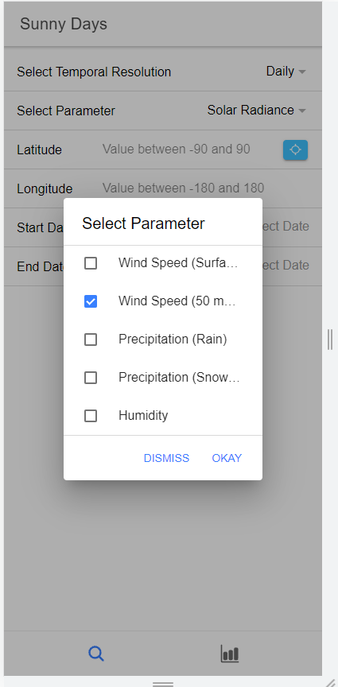
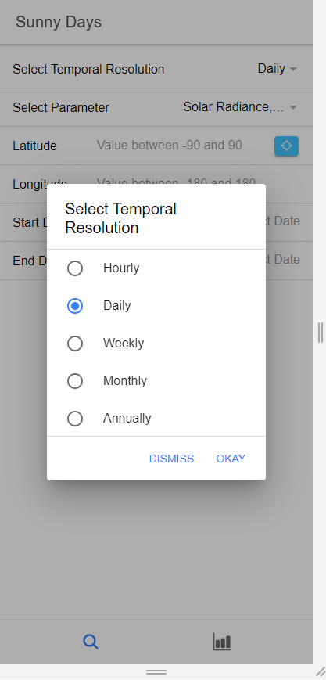
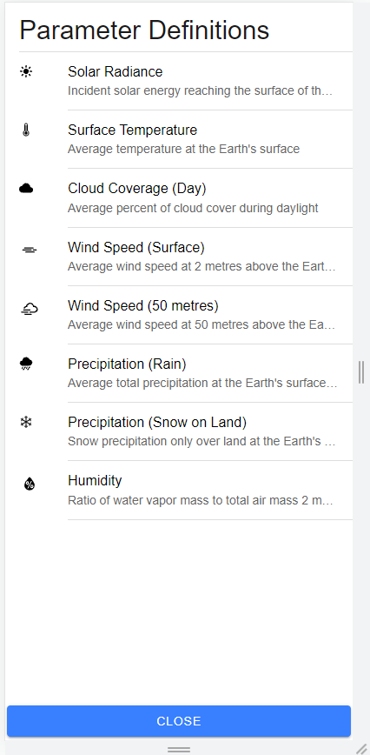
Sunny Days Mobile App - Parameters

Slide 4
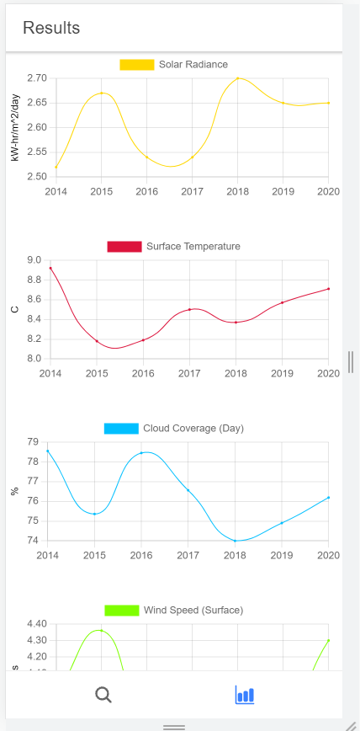
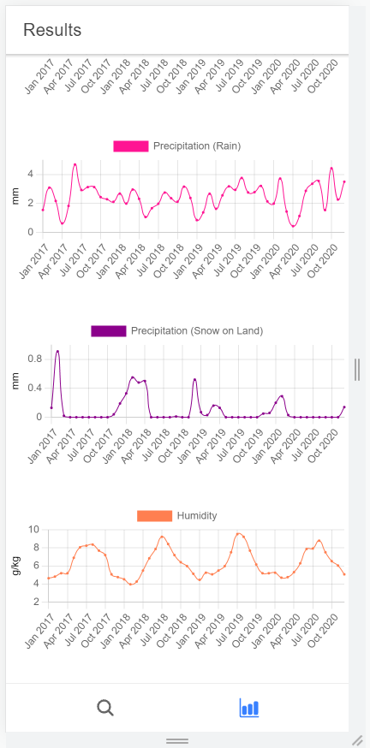
Sunny Days Mobile App
User can request multiple parameters (from the 8 available) and have line-series graphs depicted for each metric via Chart.js
Units for each metric are included
X axis changes depending on temporal resolution

